Slide 1
Unit 1 :
Introduction to Data Structure
(Time and space complexity)

Slide 2
TIME AND SPACE COMPLEXITY OF ALGORITHM
To analyze an algorithm means determining the amount of resources (such as time and storage) needed to execute it.
Algorithms are generally designed to work with an arbitrary number of inputs, so the efficiency or complexity of an algorithm is stated in terms of time complexity and space complexity.
The time Complexity of an algorithm is basically the running time of the program as a function of the input size.
On similar grounds, space complexity of an algorithm is the amount of computer memory required during the program execution, as a function of the input size

Slide 3
TIME AND SPACE COMPLEXITY OF ALGORITHM
Time complexity of an algorithm depends on the number of machine instructions in which a program executes.
This number is primarily dependent on the size of the program's input and the algorithm used.
The space needed by a program depends on:
Fixed part: that varies with problem to problem.
It includes space needed for storing instructions, constants, variables and structured variables
(like arrays, structures)
Variable part: that varies from program to program.
It includes space needed for recursion stack, and for structured variables that are allocated space dynamically during the run-time of the program.

Slide 4
Calculating Algorithm Efficiency
If a function is linear (without any loops or recursions), the efficiency of that algorithm or the running time of that algorithm can be given as the number of instructions it contains.
If an algorithm contains certain loops or recursive functions then the efficiency of that algorithm may vary depending on the number of loops and the running time of each loop in the algorithm.
The efficiency of an algorithm is expressed in terms of the number of elements that has to be processed. So, if n is the number of elements, then the efficiency can be stated as
f(n) = efficiency
Linear loops
for(i=0;i<n;i++)
statement block
f(n) = efficiency
Logarithmic Loops
for(i=1;i<n;i*=2) for(i=0;i<n;i/=2)
statement block; statement block;
f(n) = log n f(n) = log n

Slide 5
Calculating Algorithm Efficiency contd.
Nested Loops
Total no. of iterations = no. of iterations in inner loop * no. of iterations in outer loop
In case of nested loops, we will analyze the efficiency of the algorithm based on whether it’s a linear logarithmic, quadratic or dependent quadratic nested loop.
Linear logarithmic
for(i=0;i<n;i++)
for(j=1; j<n;j*=2)
statement block;
f(n)= n log n
Quadratic Loop
for(i=0;i<n;i++)
for(j=1; j<n;j++)
statement block;
f(n) = n * n
Dependent Quadratic
for(i=0;i<n;i++)
for(j=1; j<i; j++)
statement block;
f(n) = n (n + 1)/2

Slide 6
Types of Asymptotic Notations
We use three types of asymptotic notations to represent the growth of any algorithm, as input increases:
Big Theta (Θ)
Big Oh(O)
Big Omega (Ω)

Slide 9


Slide 12
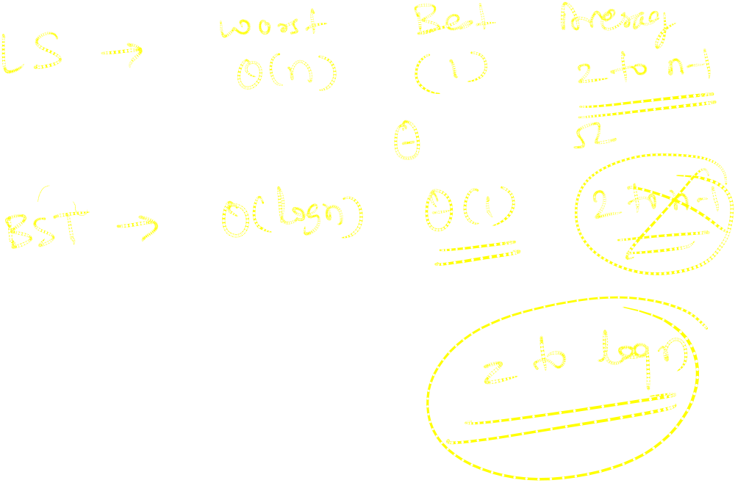

Slide 13
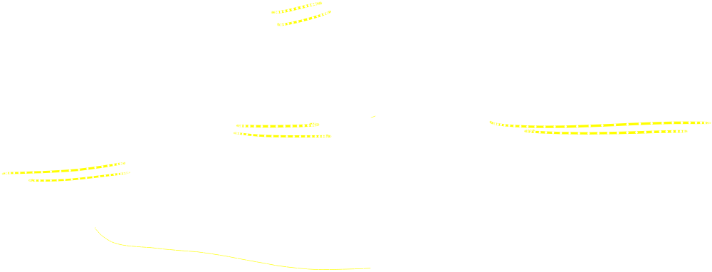
Tight Bounds: Theta (Average case)
Tight bound: means that the time complexity represented by the Big-Θ notation is like the average value or range within which the actual time of execution of the algorithm will be.
For example, if for some algorithm the time complexity is represented by the expression 3n² + 5n, and we use the Big-Θ notation to represent this, then the time complexity would be Θ(n²), ignoring the constant coefficient and removing the insignificant part, which is 5n.

Slide 14
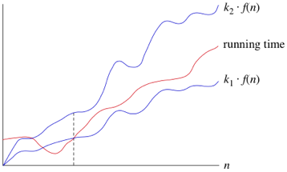
Tight Bounds: Theta (Average case)
Here, in the example above, complexity of Θ(n²) means,
that the average time for any input n will remain in between, k1 * n² and k2 * n²,
where k1, k2 are two constants, there by tightly binding the expression representing the growth of the algorithm

Slide 15
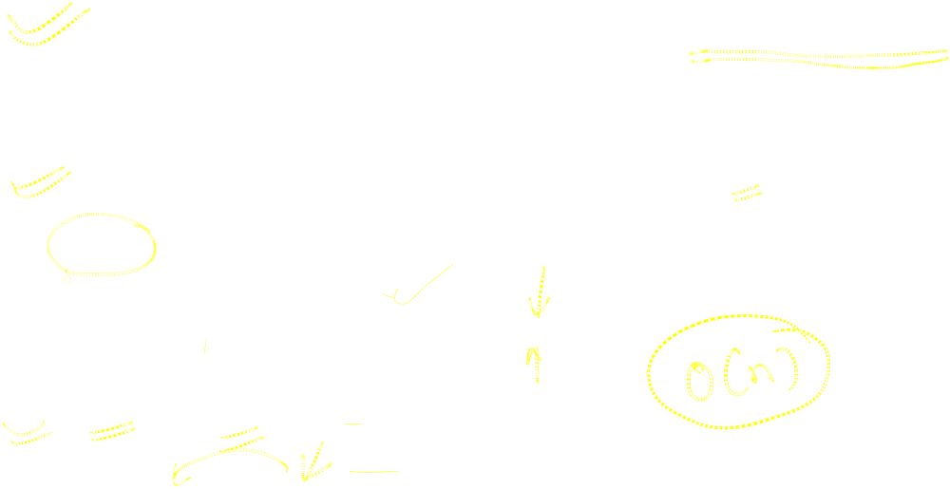
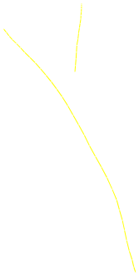
BIG OH (O) NOTATION (Worst case)
Big-Oh notation where the "O" stands for "order of" is concerned with what happens for very large values of n.
For example, if a sorting algorithm performs n² operations to sort just n elements, then that algorithm would be described as an O(n²) algorithm.
When expressing complexity using Big Oh notation, constant multipliers are ignored. So a O(4n) algorithm is equivalent to O(n), which is how it should be written.
If f(n) and g(n) are functions defined on positive integer number n, then
f(n) = O(g(n))
That is, f of n is big oh of g of n if and only if there exists positive constants c and n, such that
f (n) ≤ Cg(n) ≤ n
This means that for large amounts of data, f(n) will grow no more than a constant factor than g(n). Hence, g provides an upper bound.

Slide 16
Categories of Algorithms
Constant time algorithm that have running time complexity given as O(1)
Linear time algorithm that have running time complexity given as O(n)
Logarithmic time algorithm that have running time complexity given as O(log n)
Polynomial time algorithm that have running time complexity given as O(nk) where k>1
Exponential time algorithm that have running time complexity given as O(2^{n})
n | O(1) | O(log n) | O(n) | O(n log n) | O(n²) | O(n³)
1 | 1 | 1 | 1 | 1 | 1 | 1
2 | 1 | 1 | 2 | 2 | 4 | 8
4 | 1 | 2 | 4 | 8 | 16 | 64
8 | 1 | 3 | 8 | 24 | 64 | 512
16 | 1 | 4 | 16 | 64 | 256 | 4,096
Number of operations for different functions of n

Slide 17
Lower Bounds: Omega (Best Case)
Big Omega notation is used to define the lower bound of any algorithm or we can say the best case of any algorithm.
This always indicates the minimum time required for any algorithm for all input values, therefore the best case of any algorithm.
In simple words, when we represent a time complexity for any algorithm in the form of big-Ω, we mean that the algorithm will take at least this much time to complete it's execution. It can definitely take more time than this too.

